Slide 1
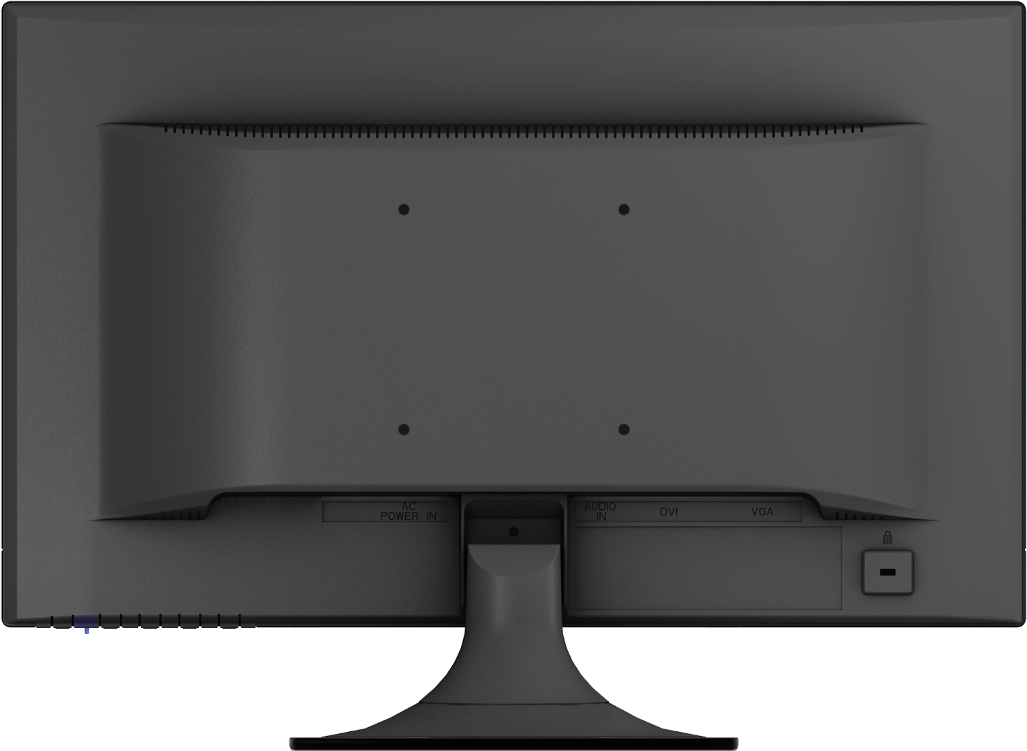
Movie Recommendation System
Md. Shamaun Nabi (18201050)
Md. Musfiqur Rahman (18201054)
Al Amin (18201063)

Slide 2
INTRODUCTION
A movie recommendation is important in our social life due to its strength in providing enhanced entertainment.

Slide 3
Motivation
A movie recommendation is important in our social life due to its strength in providing enhanced entertainment.

Slide 4
Problem Definition
There are systems which deal with the self-recommendation rather than considering the likes and dislikes of users, we thereby build a system that intakes the users wishes and then recommends a watch-list of movies which is based on their selected genre.

Slide 5
Objective, Solution and Project Output
Improve retention
Caters to the user’s preferences and keeps them hooked to the application.
Increase sales
Can improve business by a great margin by giving various recommendations of
different items.
Form habits
Influencing usage patterns in users.
Accelerate work
Helps the analysts for further research and reduces their work

Slide 6
Conflicting
Requirement
when a single item is represented with two or more different names or listings of items having similar meanings; in such conditions, the recommendation system can’t recognize whether the terms show various items or the same item

Slide 7
Impact on
Society
The aspect of study is to check the level of acceptance of the system by the user. This includes the process of training the user to use the system efficiently. The user must not feel threatened by the system, instead must accept it as a necessity. The level of acceptance by the users solely depends on the methods that are employed to educate the user about the system and to make him familiar with it

Slide 8
Critical Challenges
01
Content-based recommendation system
02
Collaborative filtering recommendation system
Based on user surveys and evaluations, recommendation systems can be characterized into two parts-

Slide 9
Critical Challenges
01
Cold start
04
Synonymy
02
Sparsity
03
Scalability
new items are added to the system, a new item can’t recommend to users initially
Synonymy arises when a single item is represented with two or more different names or listings of items having similar meaning
finding a set of users with similar ratings or interest
One biggest issue is the scalability of algorithms having real-world datasets under the recommendation system

Slide 10
Critical Challenges
04
Privacy
07
Latency
Generally, an individual needs to feed his persona information to the recommendation system
only already existing products are recommended to users as newly added products are not rated yet.

Slide 11
How As are addressed through the project
As | Attribute | How As are addressed through the project
A1 | Range of Resources | In development stage, the project requires the use of diverse resources including different type of material : Movie dataset Information’s: Movie metadata, Movie knowledge Technologies: machine learning(ML) model for supervised, People: Developers. Designer, Analyzer
A2 | Level of Interaction | A better interaction is required among the researchers and developers (student), Viewers and participants (system users).
A3 | Innovation | A degree of innovation is required to develop the machine-learning based supervised learning model using the available data set.
A4 | Consequences for society and the environment | Because of this, our viewers are going to have a more convenient platform. Even in the condition of having physical distance, people can choose their desired movie without wasting time and follow the updated trend.
A5 | Familiarity | The project deals with a recommendation system based on users searching, watching, viewing rating and so on analysis of participants.

Slide 12
How Ps are addressed through the project
Ps0 | Attribute | How Ps are addressed through the project
P1 | Depth of Knowledge Requirement | The project requires study of research on Machine Learning system mainly supervised learning model, Digital data processing (K8) Data collection from user sites like online movies specially movies, series, web series, documentation film etc.(K7) Engineering design (multi-layer model design) (K5) and user interface development (K6) knowledge of software engineering and data pre-processing (feature extension), various algorithms (K3, K4, k2).
P2 | Range of Conflicting Requirement | Create an appropriate machine-learning model to detect a movie from similar type movies.
P3 | Depth of Analysis Required | Use supervised machine learning model, a type of machine learning model instead of tensor-flow or other API based movie detection algorithm.
P4 | Familiarity of Issues | Based on searching detection, choice of genre related online result, decision or movie tag.
P5 | Extent of applicable codes | Using Yolov4 supervised learning model and other industrial standard library functions, build the proper solution model and user interface with data synchronization of the proposed system.
P7 | Interdependence | Creating model (algorithmic part), classify data characteristic, proposed user application interface.

Slide 13
CO-PO mapping for this project
CO No. | CO Statements | Corresponding POs (Appendix-1)
CO1 | Identify a real-life problem (Recommendation System) that can be translated to an engineering and/or computing solution through design, development and validation | 12
CO2 | Identify outcomes and functional requirements of the proposed solution (Movie Recommendation System) considering web based and/or hardware specification and standards | 1,2
CO3 | Identify sub components of a complex problem, prepare timeline and appropriate budget using the project management skill | 11
CO4 | Identify and validate the impact of environmental considerations and the sustainability of a system/subsystem of a complete project | 7
CO5 | Assess professional, ethical, and social impacts and responsibilities of the design project | 6,8

Slide 14
CO-PO mapping for this project
CO No. | CO Statements | Corresponding POs (Appendix-1)
CO6 | Function effectively in a multi-disciplinary team | 9
CO7 | Analyze, design, build, and evaluate engineering/computing system/subsystem with given specifications and requirements | 3,4,5
CO8 | Present design project results through oral presentations | 7

Slide 15
No | PO | Differentiating Characteristic
1 | Engineering Knowledge | Breadth and depth of education and type of knowledge, both theoretical and practical
2 | Problem Analysis | Complexity of analysis
3 | Design/ development of solutions | Breadth and uniqueness of engineering problems i.e. the extent to which problems are original and to which solutions have previously been identified or codified
4 | Investigation | Breadth and depth of investigation and experimentation
5 | Modern Tool Usage | Level of understanding of the appropriateness of the tool
6 | The Engineer and Society | Level of knowledge and responsibility
7 | Environment and Sustainability | Type of solutions.
8 | Ethics | Understanding and level of practice
9 | Individual and Team work | Role in and diversity of team
10 | Communication | Level of communication according to type of activities performed
11 | Project Management and Finance | Level of management required for differing types of activity
12 | Lifelong learning | Preparation for and depth of Continuing learning.

Slide 16
Project management (Time-Table)
Lab | Working Progress
Lab 1 | Introduction
Lab 2 | Project Proposal Permission
Lab 3 | Project Proposal Permission
Lab 4 | Planning and Requirement Analysis
Lab 5 | Requirement Analysis and data collecting
Lab 6 | UI/Ux Planning
Lab 7 | Data pre-processing
Lab 8 | Data pre-processing
Lab 9 | Model Building
Lab 10 | Model Building
Lab 11 | Model Building
Lab 12 | Connect with Web
Lab 13 | Deployment
Lab 14 | Final Presentation and Submission

Slide 17
THANKS

